Slide 1
A Taste of PL
Theory and Applications
Notes:
How many have or plan to take CS 456 or CS 565?
undergrad and graudate programming languages

Slide 2
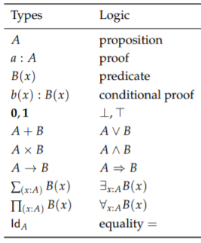
PL Research?
Software Engineering meets Formal Mathematics
A programming language as a Logic
And proofs as programs
How to prove things about programs
Notes:
What is PL research?
Its where software engineering meets formal mathematics
For the purpose of defining new programing languages.
Many different types of languages out there and in the broadest sense they are theoretically equally powerful
But you wouldn’t use excel to write up a new numerical methods library
And you wouldn’t use C to write a formal proof.
The types of languages
Lambda calulus
Types rule out non well formed sentences
which can be programs, proofs or both
Mathematically verify the properties for the calclus you are using for soundness and completeness
proofs within your calculus are then valid with respect to its semantics

Slide 3
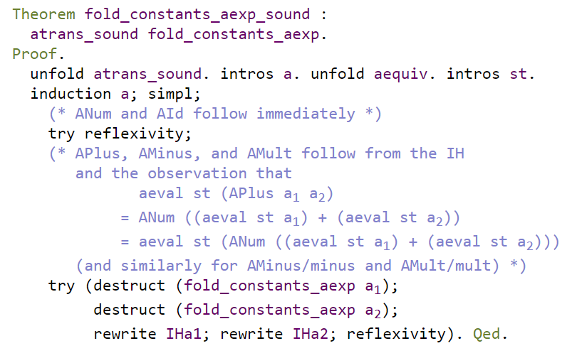
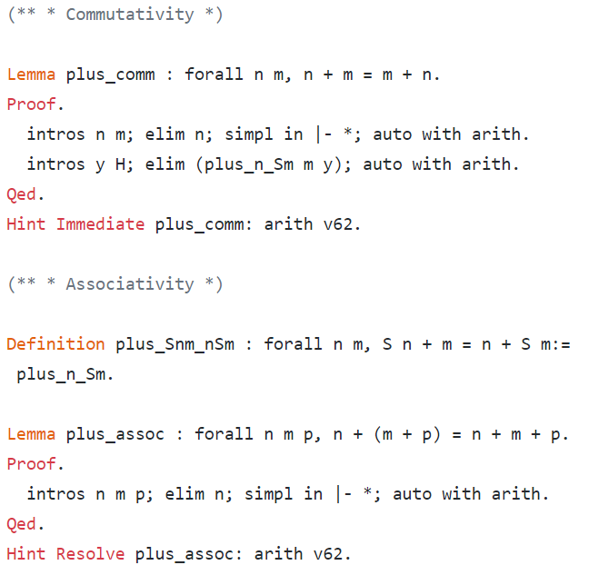
The Tools
Coq, Agda, Idris, NuPRL, Cedille …
Notes:
Used in Engineering and Mathematics
Left:
represent the AST of an imperative language
wrote a transformation for constant folding which is a compiler optimization
proved that this transformation is sound
for any possible program(represented by our ast) going into that transformation,
the resulting program after the transformation is behaviorally equivalent
Different than writing test cases which capture some possible cases
With proof assistant, appropriate representation you can prove for all cases in a very general way
Proof tactics
can write your own proof tactics
automated decision procedures
Fiet Thompson - every finite group of odd order is solvable.

Slide 4

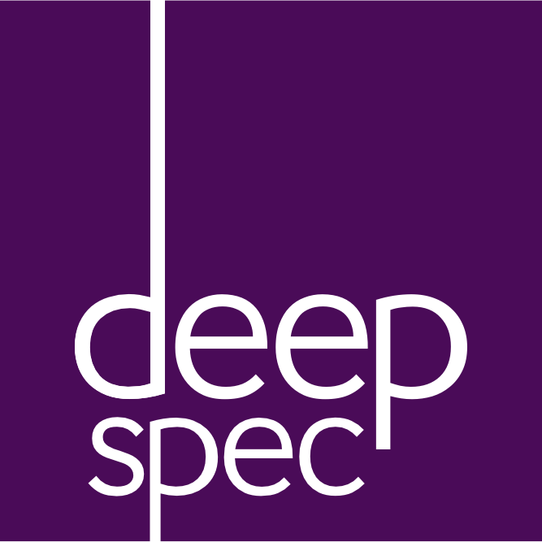
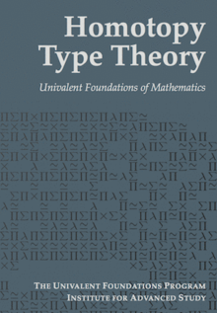


Some Projects
Compcert
Rust
Deep Spec
Notes:
Rust
A "memory safe language"
Part of the ML family, but feels like C
Safe and unsafe mode
(similar to Haskell's pure and impure parts(Monad))
Safety via type system
Ownership type
Types of references (mutable, sharable, exclusive)
Reference lifetimes
Prevent
Synchronization errors
Iterator invalidation
Use after free
Double free
Achievable via substructural logic (linear logic)
Comp Cert
More famous project
Compcert C compiler
Higher guarantee that the generated code meets the semantics of the C language via method of formal proof
Project at UIUC - K Framework
Goal minimize and catch undefined and unspecified behavior in the specification of C11
Deep spec
Cross university collaboration
Princeton Penn Yale MIT
Projects
Verifying C code
Certified operating system kernels
Certifying network and cryptographic protocols
Verify hardware descriptions
Formal Verification is already present in the big name tech companies

Slide 5
Sources
https://softwarefoundations.cis.upenn.edu/plf-current/Equiv.html#lab22
https://github.com/maximedenes/native-coq/blob/master/theories/Arith/Plus.v
https://www.heidelberg-laureate-forum.org/wp-content/uploads/2013/10/Homotopy-Type-Theory_Univalent-Foundations-of-Mathematics.pdf
https://deepspec.org/page/Project/
https://www.rust-lang.org/
http://www.kframework.org/index.php/K_Publications
http://fsl.cs.illinois.edu/FSL/papers/2015/hathhorn-ellison-rosu-2015-pldi/hathhorn-ellison-rosu-2015-pldi-public.pdf
http://plv.mpi-sws.org/rustbelt/

